Slide 1

GRAPHS
NITESH AND SHITIJ

Slide 2
GRAPH
A graph ‘G’ consist of a vector set V(G) and an edge set E(G) and a relation that associates each edge to vertices which are called its endpoints. A graph is denoted as
G = (V, E)
Vertices -- v1, v2, v3, v4, v5
Edges -- e1, e2, e3, e4, e5
Loop – e6

Slide 3
Parallel edge – If two or more edges of a graph G have same end vertices then these edges are called parallel edges.
Isolated vertex - A vertex of graph G which is not the endpoint of any edge is called isolated edge.
Adjacent edge - Two vertices which are joined by an edge are called adjacent edge.
LOOP - It is an edge whose end points are same.

Slide 4
Degree - the degree Deg(V) of any vertex V of graph G is the number of edges incident with vertex V. Each loop is counted twice.
c
d
g
h
b
a
f
e

Slide 5
Simplex graph - A graph which has no loops or multiple edges is called simplex graph.
Trivial graph - A finite graph with one vertex and no edges is called trivial graph.
Pseudo graph - A graph having loops but no multiple edges is called pseudo graph.
Multiple graph - A graph having some parallel edges.
Directed graph – A graph ‘G’ is called directed graph if elements of e are associated with ordered pair of vertices. i.e. vertices are connected by straight lines with directions.
Mixed Graph – A graph ‘G’ is called mixed graph if it's some edges are directed and some are undirected.
In-degree and out-degree - in a directed graph ‘G’ the number of edges ending at vertex V is called in degree of V it is denoted by Indeg(V)
and
number of edges beginning from B is called out degree of B and it is noted as Outdeg(V).

Slide 6

Pendent vertex – A vertex of graph with degree one is called pendant vertex.
Order of Graph - if G = (V, E) is a finite graph then number of vertices in a graph is called order of graph.
Size of Graph – if G = (V, E) is a finite graph then the number of edges in a graph is called size of a graph.
v5
v4
v7
v6
v1
v2
v3

Slide 7
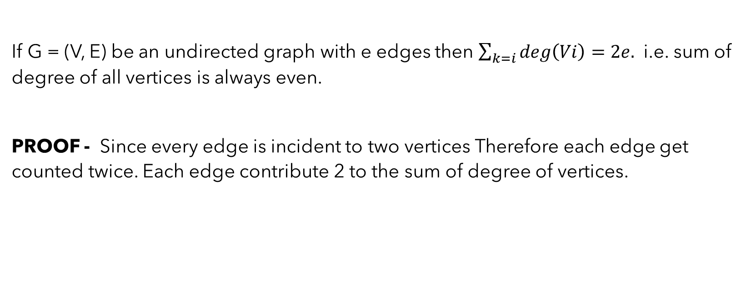
The handshaking Theorem
If G = (V, E) be an undirected graph with e edges then $\sum_{k=i}{deg\left(Vi\right)=2e. }$ i.e. sum of degree of all vertices is always even.
PROOF - Since every edge is incident to two vertices Therefore each edge get counted twice. Each edge contribute 2 to the sum of degree of vertices.

Slide 8
Verify handshaking lemma
v1
v2
v3
v4
v5
v6

Slide 9
Operations on graph :
UNION OF GRAPHS –
Let G1 = (V1, E1) and G2 =(V2, E2) be two graphs whose vertex set are disjoint then the union of G1 and G2 is devoted by G1 U G2 and is defined as a graph
G = (V, E) such that
V(G) = V(G1) U V(G2)
and E(G) = E(G1) U E(G2)

Slide 10
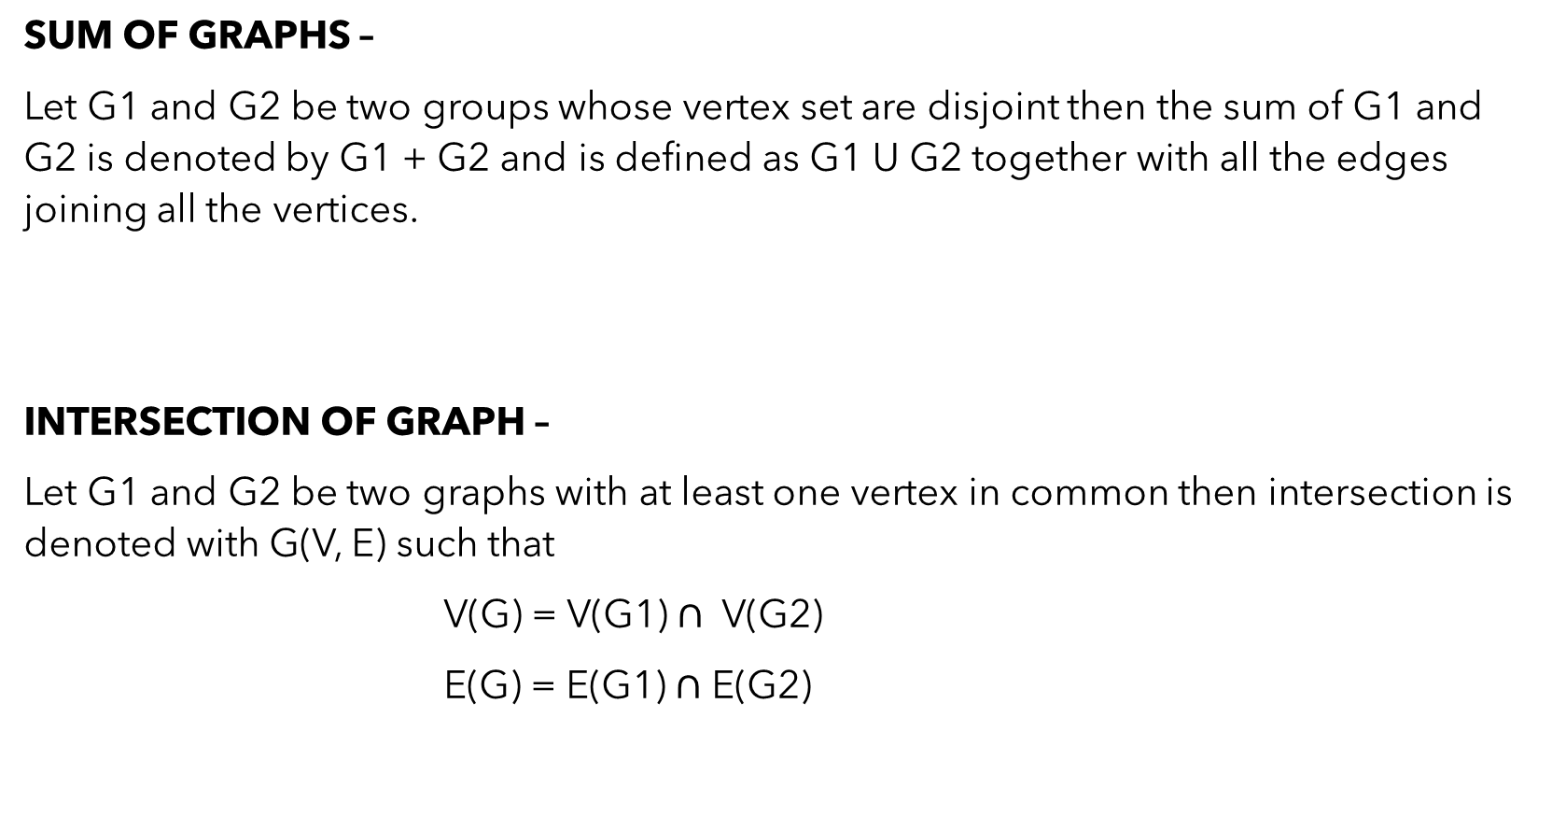
SUM OF GRAPHS –
Let G1 and G2 be two groups whose vertex set are disjoint then the sum of G1 and G2 is denoted by G1 + G2 and is defined as G1 U G2 together with all the edges joining all the vertices.
INTERSECTION OF GRAPH –
Let G1 and G2 be two graphs with at least one vertex in common then intersection is denoted with G(V, E) such that
V(G) = V(G1) $∩$ V(G2)
E(G) = E(G1) $∩$ E(G2)

Slide 11
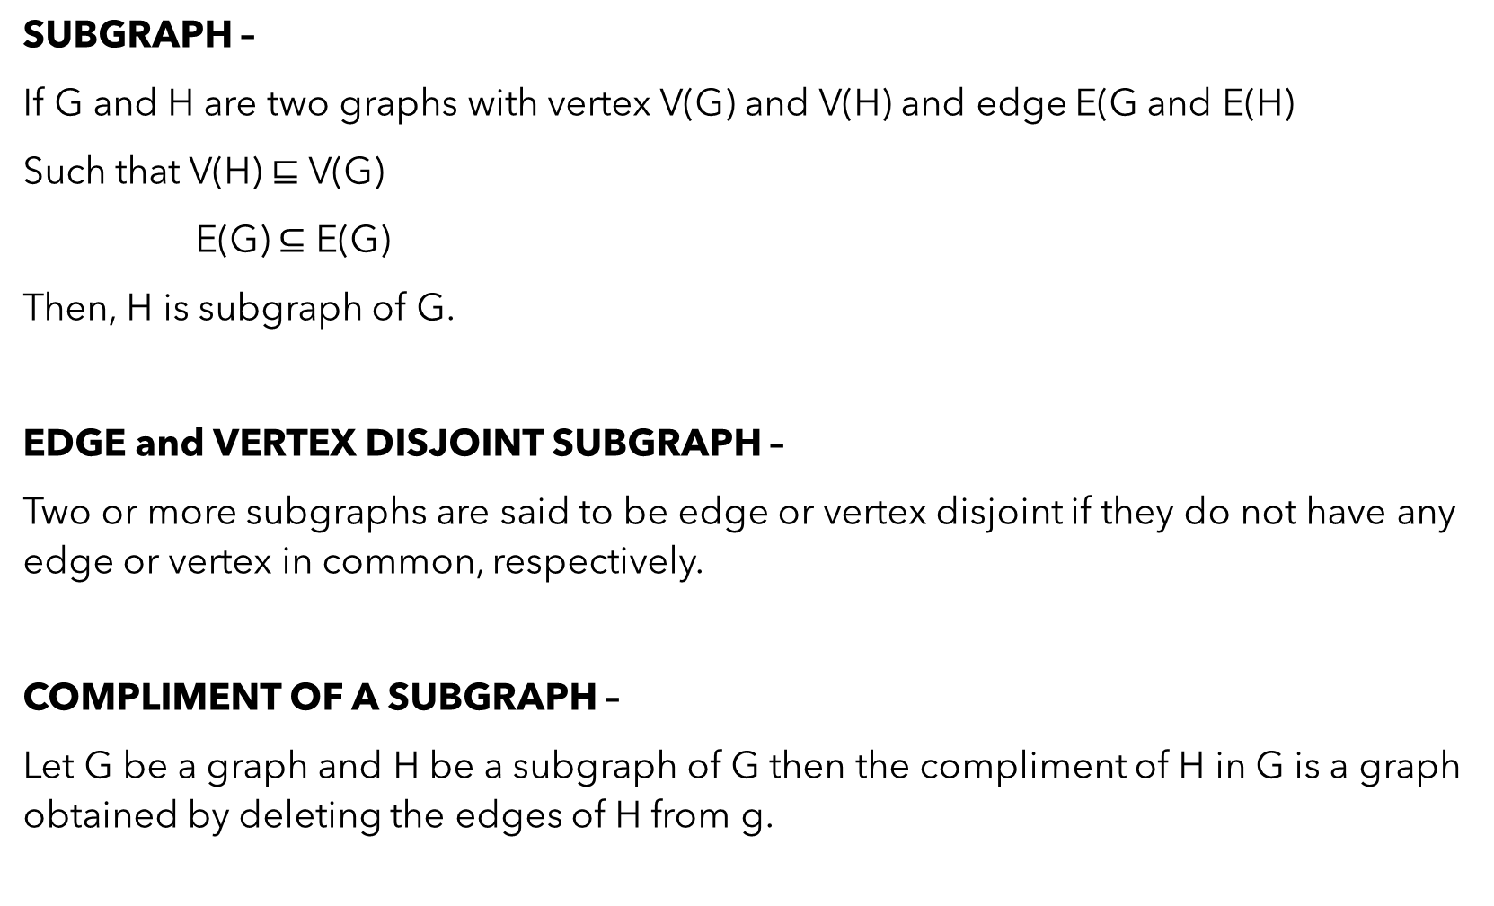
SUBGRAPH –
If G and H are two graphs with vertex V(G) and V(H) and edge E(G and E(H)
Such that V(H) $⊑$ V(G)
E(G) $⊆$ E(G)
Then, H is subgraph of G.
EDGE and VERTEX DISJOINT SUBGRAPH –
Two or more subgraphs are said to be edge or vertex disjoint if they do not have any edge or vertex in common, respectively.
COMPLIMENT OF A SUBGRAPH –
Let G be a graph and H be a subgraph of G then the compliment of H in G is a graph obtained by deleting the edges of H from g.

Slide 12
THANK YOU

